Slide 1
Infinity Week
B2 Friday - The Future of Medicine

Slide 2
What comes to mind when you hear the word 'medicine'?
Where do you go for medical advice?
Do you ever use Google to look up medical information?
What aches and pains do you get?
What do you think of chatbots?
Have you used ChatGPT?
In what ways might ChatGPT help doctors?
What will the AI revolution in medicine look like?
How do you think AI might help your health in the future?

Slide 3
Feedback Session
Pronunciation
Grammar
Vocabulary

Slide 4
Rank these ways of getting a medical diagnosis with your partner.
Put the best sources for medical diagnoses at the top.
Change partners often and share your rankings and explain your reasons.
ChatGPT-4
Doctors
Google
Nurses
Your grandmother
Medical books
Alternative medicine
Your own feelings

Slide 5
Match the words on left with the correct definitions on the right.
1. | relied on | a. | A statement that something is unsatisfactory or unacceptable.
2. | complaint | b. | The arrival of an important person or thing.
3. | diagnose | c. | Depended on with full trust or confidence.
4. | advent | d. | A doctor who is qualified to operate on people.
5. | unveiled | e. | Showed or announced publicly for the first time.
6. | surgeon | f. | Having a decisive or key importance in the success, failure, or existence of something.
7. | critical | g. | Identify the nature of an illness or other problem by examination of the symptoms.

Slide 6
Who/what do you rely on in your life?
Have you ever diagnosed an illness yourself?
How do you feel about the advent of AI?
What exciting new products have been unveiled recently?
Would you like to be a surgeon? Why or why not?”
Have you ever had a medical complaint? How did you handle it?
What things are critical to your health/happiness?

Slide 7
Feedback Session
Pronunciation
Grammar
Vocabulary

Slide 8
Decide with a partner where these words go in the spaces in the paragraph. Listen to check your answers.
complaints
potential
decades
titled
unveiled
advice
artificial
tool
For the past few (1) _____________________, many of us have relied on "Doctor Google" to self-diagnose aches, pains and (2) _____________________. The advent of AI has brought a much more powerful (3) _____________________ to assist with medical diagnoses - ChatGPT-4. This is the next-generation version of the chatbot ChatGPT, which was (4) _____________________ only four months ago. Doctors believe the new AI will revolutionize their work and improve the lives of their patients. Three (5) _____________________ intelligence experts have written an e-book (6) _____________________: "The AI Revolution in Medicine". In it, they say ChatGPT-4 will provide surgeons with critical, life-saving (7) _____________________ and information in real time. The authors say: "We need to start understanding and discussing AI's (8) _____________________."

Slide 9
Listen to your teacher and practice the pronunciation.
Which words are emphasised (said more strongly)?
Try to copy how your teacher reads the text then read it to
your partner.
For the past few decades, many of us have relied on "Doctor Google" to self-diagnose aches, pains and complaints. The advent of AI has brought a much more powerful tool to assist with medical diagnoses – ChatGPT-4. This is the next-generation version of the chatbot ChatGPT, which was unveiled only four months ago. Doctors believe the new AI will revolutionise their work and improve the lives of their patients. Three artificial intelligence experts have written an e-book titled: "The AI Revolution in Medicine". In it, they say ChatGPT-4 will provide surgeons with critical, life-saving advice and information in real time. The authors say: "We need to start understanding and discussing AI's potential.

Slide 10
The advent
This is the next-generation
unveiled only
provide surgeons with critical, life- saving
We need to start understanding and
ChatGPT-4 will become invaluable
all the world's medical knowledge at
AI is not yet a panacea for
sound
they cautioned against using AI without
PHRASE MATCH: (Sometimes more than one choice is possible).
Decide with your partner which phrases match.
to medical practitioners
advice and information
medical advice
human supervision
version of the chatbot
all medical complications
of AI
discussing AI's potential
your disposal
four months ago

Slide 11
Check your answers.
Listen to how your teacher says these sentences.
Try to copy how your teacher says them!
The advent of AI
This is the next-generation version of the chatbot
…unveiled only four months ago…
…provide surgeons with critical, life- saving advice and information
We need to start understanding and discussing AI's potential
ChatGPT-4 will become invaluable to medical practitioners
…all the world's medical knowledge at your disposal
AI is not yet a panacea for all medical complications
…they cautioned against using AI without human supervision/sound medical advice

Slide 12
How do you think AI might help you take care of your health?
Have you ever used a chatbot?
How might AI help
doctors to treat patients?
What do you think of chatbots?
What might be the dangers of using AI in medicine?

Slide 13
Feedback Session
Pronunciation
Grammar
Vocabulary

Slide 14
How can I use Chat GPT?
First, go to https://chat.chatgptdemo.net/
Then, write a prompt:

Slide 15
Write a prompt for Chat GPT about the future of healthcare.
Enter your prompt at: https://chat.chatgptdemo.net/
Read it and ask your teacher to explain anything you don’t understand.
Take 5 minutes to plan how you will explain it to your partner.
Talk to your partner and explain any new language for them.

Slide 16
Feedback Session
Pronunciation
Grammar
Vocabulary

Slide 17
Unless we are careful, AI may harm us in the future because it may get out of control.
The underlined words above help us to link our ideas.
These words are called connectives.
Discuss with your partner how even though and as long as help us to link our ideas.
B
A
C
What other words can we use to link two or more ideas together?
Share your ideas with the group and ask your teacher about
anything you are not sure about.

Slide 18
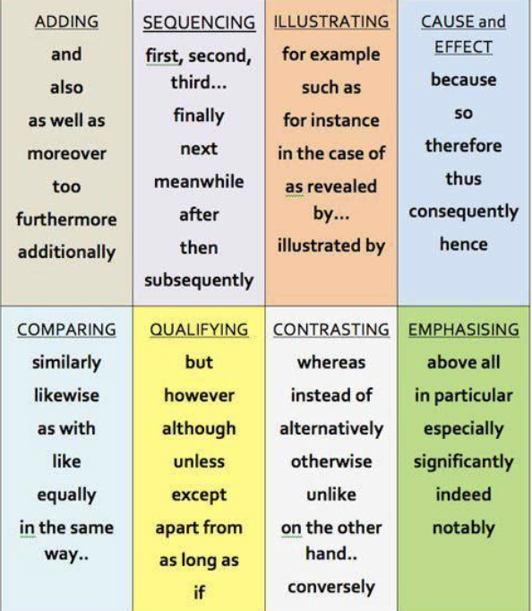
Match the functions on the left to the connectives.
Check with your teacher.
Adding
Sequencing
Illustrating
Cause and effect
Emphasising

Slide 19
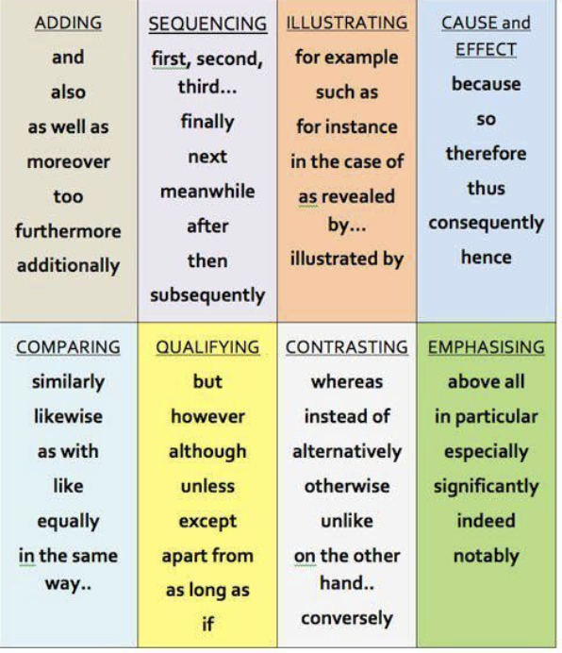
With a partner, write 5 sentences about using AI in medicine. Use connectives!

Slide 20
Role A – AI is better than doctors
You think AI is the best source of medical diagnoses. Tell your partner why. Tell them what is wrong with their argument and why.
Role B – Traditional doctors are better than AI
You think human doctors are the best source of medical diagnoses. Tell your partner why. Tell them what is wrong with their argument and why.
Use as many of the connectives you have learned!

Slide 21
Feedback Session
Pronunciation
Grammar
Vocabulary

Slide 22
Tell your partner/group three useful things you have learned in English in this class (e.g., new vocabulary, grammar, pronunciation., tc.)

